Slide 1


English to Hindi Translation Using Attention Mechanism
Leveraging Deep Learning for Neural Machine Translation
Presenter:Kavisha Jain

Slide 2



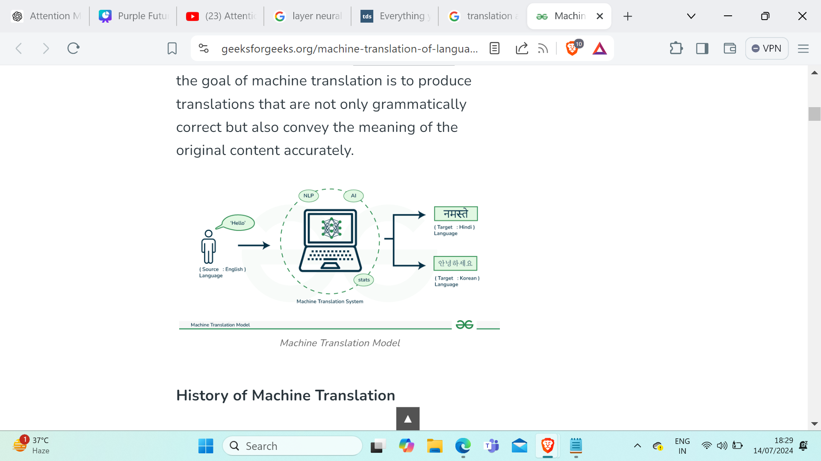
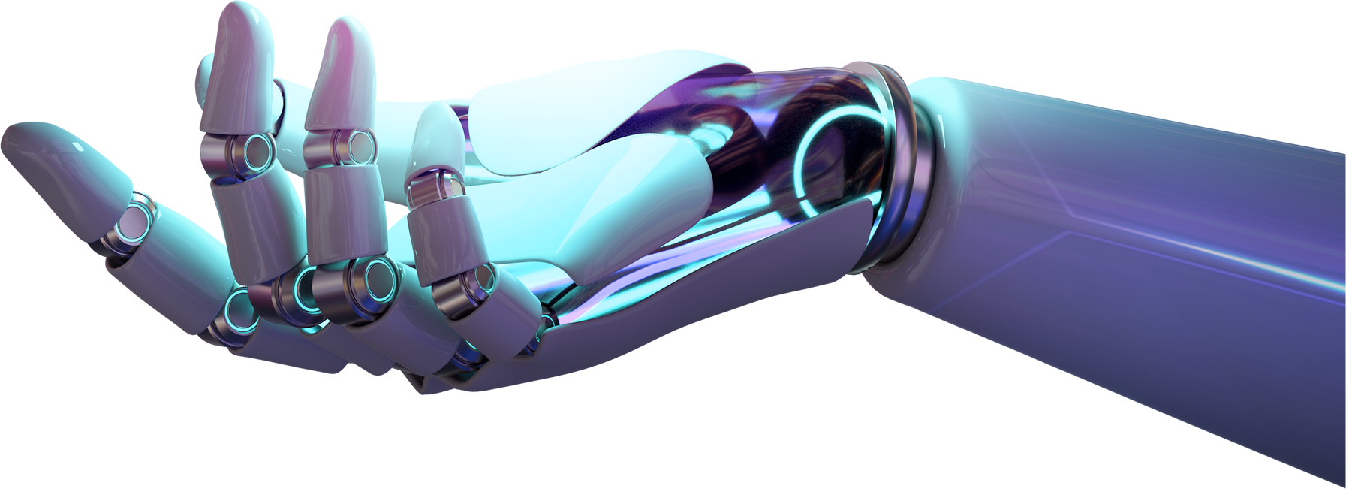
02
Problem Statement
Objective: To develop an efficient Neural Machine Translation (NMT) system that translates English sentences into Hindi using an attention mechanisms.

Slide 3


03
Motivation
Global Communication
Accessibility
Efficiency
Scalability
Innovation

Slide 4




04
Methodology
Data Collection
Preprocessing
Model Selection
Gather relevant data from diverse sources.
Clean, Removing irrelvent characters from sentaences
Choose and train DL algorithms for peak performance.

Slide 5


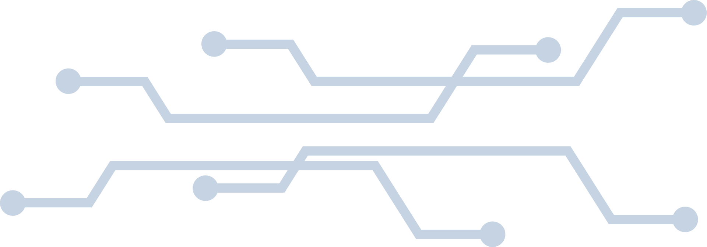
05
Data Collection and Preprocessing
We gather relevant datasets from relevrnt sources and clean, and preprocess the data to ensure its quality and consistency. This step is crucial for training accurate and reliable DL models.

Slide 6
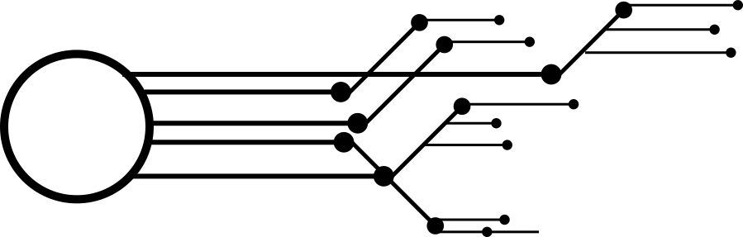
06
Attention Mechanism
Compare to human attention,
focusing on relevant parts of a sentence.
The attention layer calculates the attention weights, which determine the importance of each word in the input sentence for generating the current word in the output sentence.
The context vector is computed as a weighted sum of the encoder outputs, where the weights are the attention scores.

Slide 7
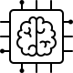
07
Attention Mechanism
Compare to human attention,
focusing on relevant parts of a sentence.
1.Encoder: Encodes the input sequence into a sequence of hidden states.
2.Decoder: Generates the output sequence using the context vectors provided by the attention mechanism.
3.Attention Layer: Computes the alignment scores and context vectors.

Slide 8
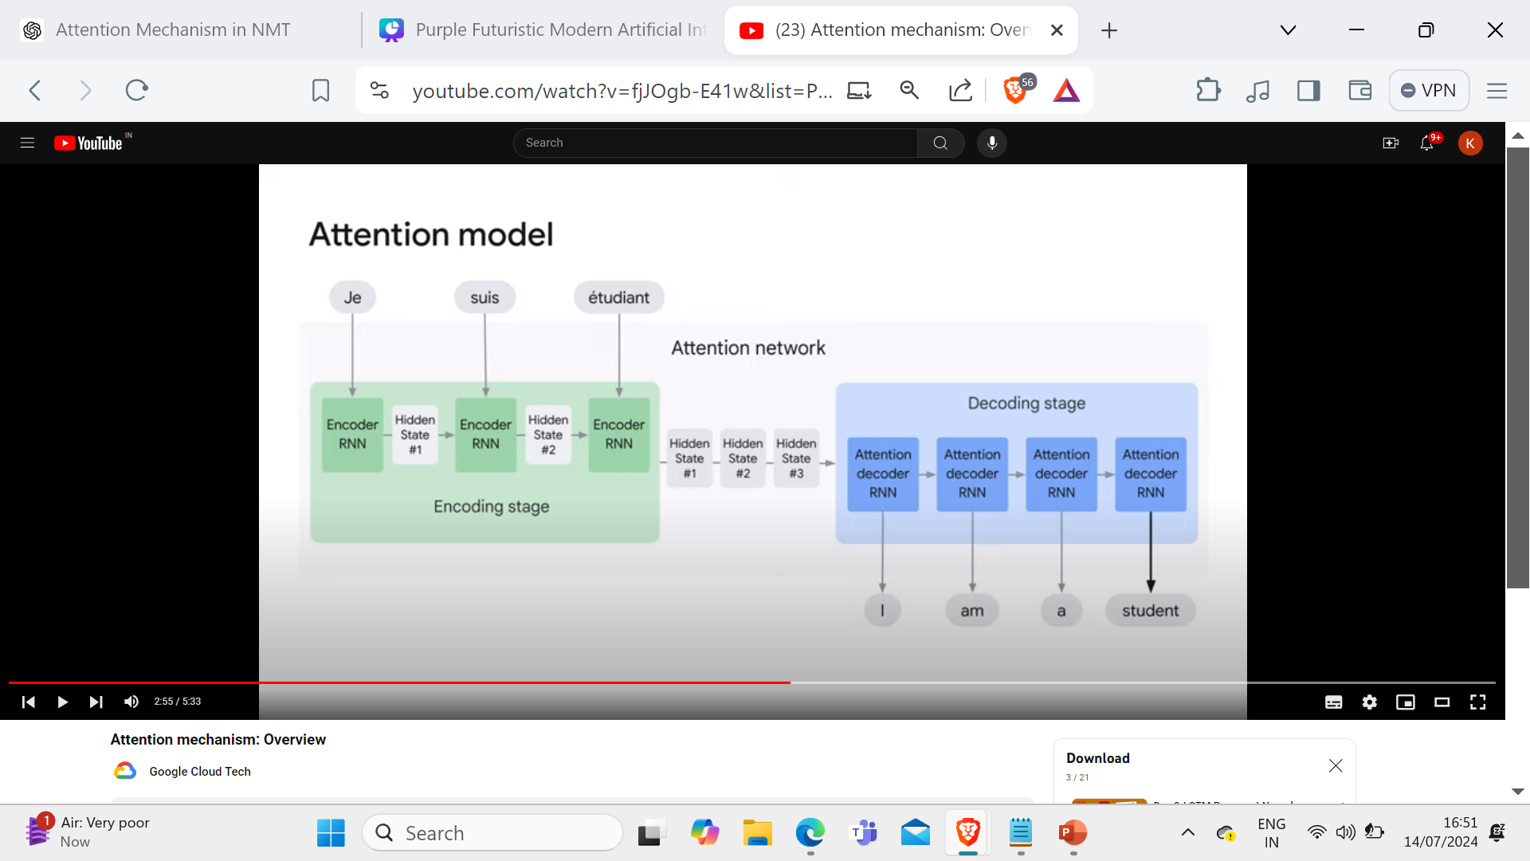
Attention Mechanism
08
Compare to human attention,
focusing on relevant parts of a sentence.
LSTM
LSTM
LSTM
LSTM
LSTM
LSTM
LSTM

Slide 9
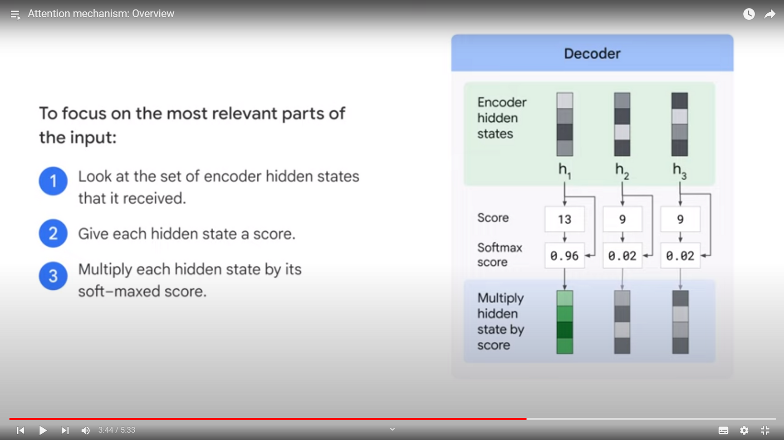
09
DECODER
1.Look at the set of encoder hidden states that it received.
2 Give each hidden state a score.
3 Multiply each hidden state by its
soft-maxed score.

Slide 10



Evaluation Metrics
10
BLEU Score: Evaluating Translation Quality
Bilingual Evaluation Understudy (BLEU) measures machine-translated text against human-translated reference text.
Scale: 0 to 1 (closer to 1 = better resemblance to reference).
Counts overlapping n-grams (word sequences) between candidate and reference translations.
Higher overlap = better translation quality.
Quick and widely adopted metric.

Slide 11



11
Result
We present the results of our AI project, showcasing improvements in performance, efficiency, and decision-making compared to traditional methods. We also discuss the potential impact of our solutions on stakeholders and end-users.

Slide 12



12
Challenges in Hindi to English Translation
Linguistic Differences
Morphological Complexity
Contextual Understanding
01
02
03
Rare and Out-of-Vocabulary Words
Resource Limitations
Handling Idiomatic Expressions
04
05
06

Slide 13
13
Conclusion
This score serves as a benchmark for assessing translation quality, highlighting strengths in basic English to Hindi translation capabilities. Areas for improvement include enhancing semantic accuracy, addressing cultural nuances, and expanding the training dataset for broader coverage

Slide 14


THANK YOU

